Slide 1
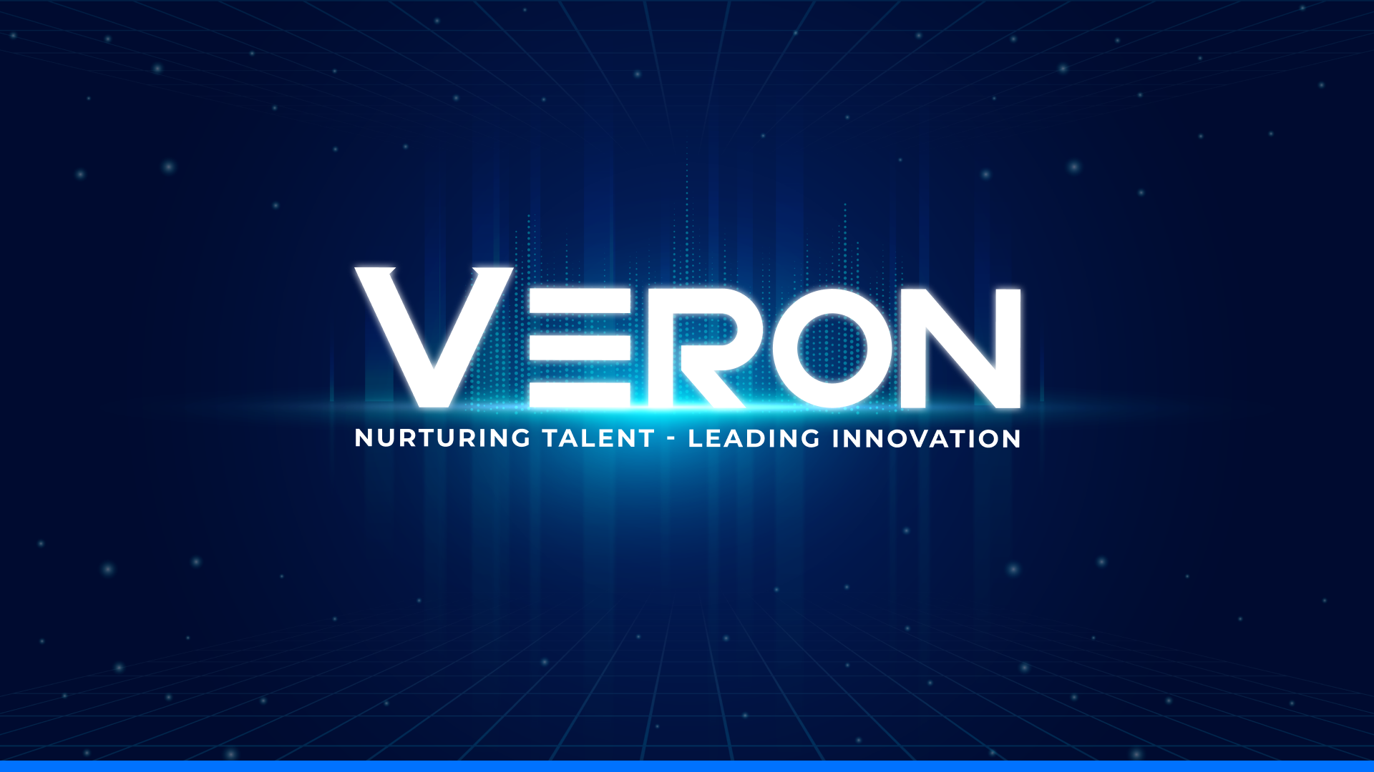

Slide 2


VERON R&D
AI
SEMICONDUCTOR
VERON R&D
AI Semiconductor
Page 01

Slide 3



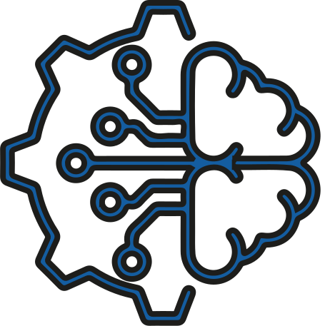



AI Semiconductor
Table of Contents
TECHNOLOGY AND
SOLUTIONS
CHALLENGES
BENEFIT
CAPABILITY
The Challenge of Server-Based AI Devices
Proposed solutions and technologies to address AI server
The benefits of Edge AI
R&D team's capabilities and potential
1
2
3
4
VERON R&D
AI Semiconductor
Page 02

Slide 4

ABOUT
US
VERON R&D, a subsidiary of VERON Group, is a semiconductor technology company specializing in comprehensive hardware solutions, including analog and digital circuit design. Building on this foundation, VERON R&D leads the way in semiconductor-based solutions and applications, such as Edge AI on FPGA, AI chips, and SBCs.
VERON R&D
AI Semiconductor
Page 03

Slide 5

Challenges
Initial Deployment
Operational
Expansion and Maintenance
Integrating AI models with devices
Latency in response
High operating costs
Data sent via API
Data format difference
Requires complex client-side software
Network transmission speed
Server processing load
Cloud service costs increase with the number of devices and frequency of access.
Security and Privacy
STAGE 1
STAGE 2
STAGE 3
Configure stable network connection
Server overload or API rate limit
Difficult to scale
Server is congested, not responding in time
Limited by cloud service plan (API rate limit)
Distributed server infrastructure is required
Unstable network, poor coverage
Lack of support for retry mechanisms, offline cache
Depends on third party platform
Devices using external AI servers
VERON R&D
AI Semiconductor
Page 04

Slide 6
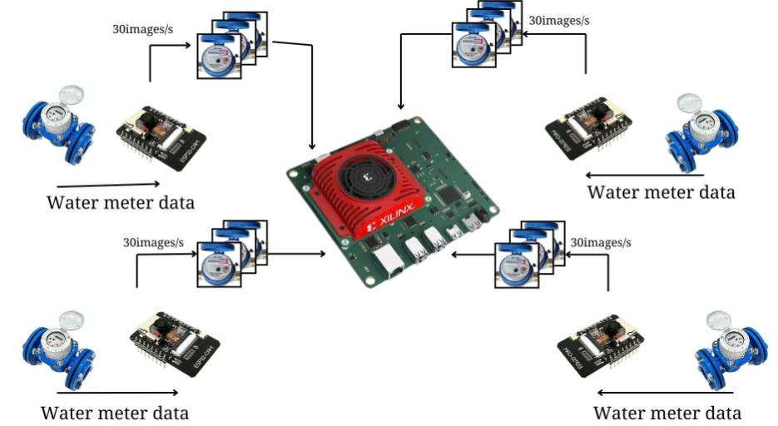
Technology
1. FPGA DPU Edge AI
Flexible configuration
Allows for the optimization of AI circuit performance
Simultaneously handling multiple task in real time
Customize models through SDK
VERON R&D
AI Semiconductor
Page 05

Slide 7
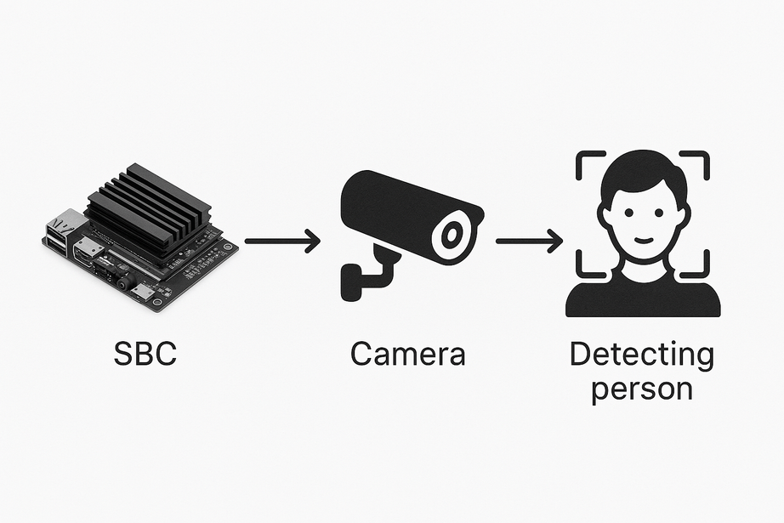
Technology
2. SBC Edge AI
On-site AI processing with rapid response ability
Independent task execution
Compact, cost-effective and swift deployment
VERON R&D
AI Semiconductor
Page 06

Slide 8
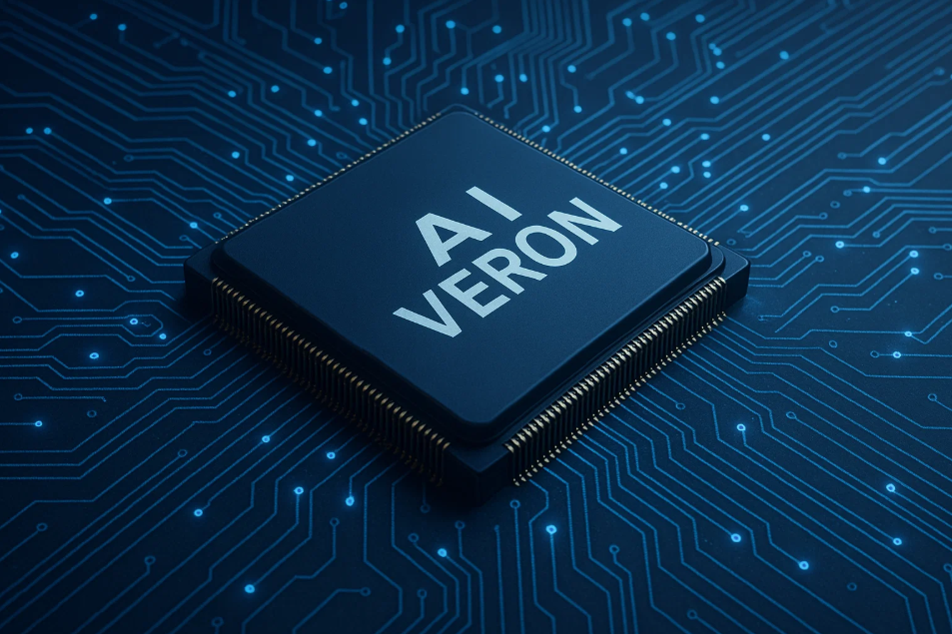
Technology
3. AI Chip
Exceptional performance in executing AI algorithms
Rapid, low-latency inference for complex neural networks
Optimal operation even in power-constrained environment
VERON R&D
AI Semiconductor
Page 07

Slide 9
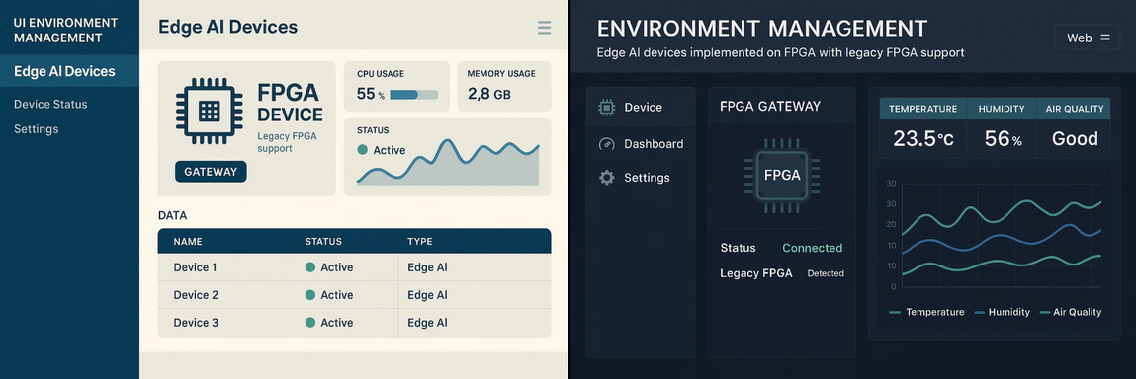

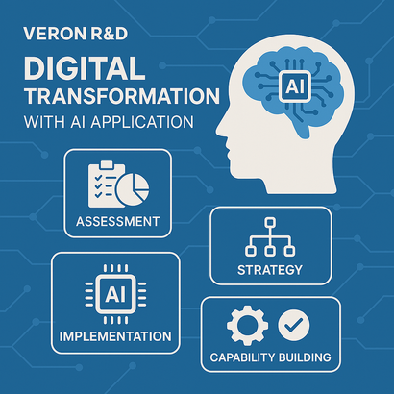
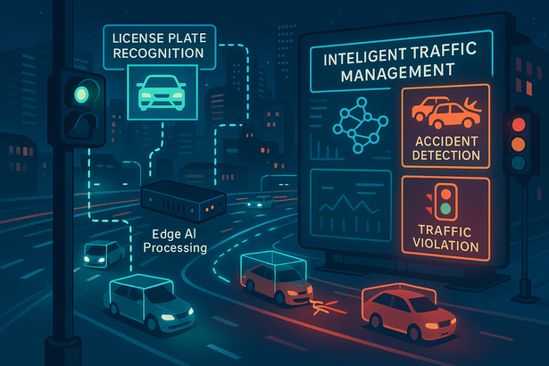
Solutions
From the IP core DPU integrated on the FPGA board or SBC board, we can get the following solutions :
Enviroment Quality Management
Traffic smart management
Puplic security smart management
Digital transformation powered by AI
VERON R&D
AI Semiconductor
Page 08

Slide 10

Benefit
Reduce latency
01
06
Power & Resource Optimization
Network Independence
02
07
Multi-model Deployment
EDGE AI
Security & Privacy
03
08
AI Safety & Failover
Save operating costs
04
09
Dynamic Reconfiguration
More scalable, more flexible
05
10
Remote Monitoring & Debugging
VERON R&D
AI Semiconductor
Page 09

Slide 11
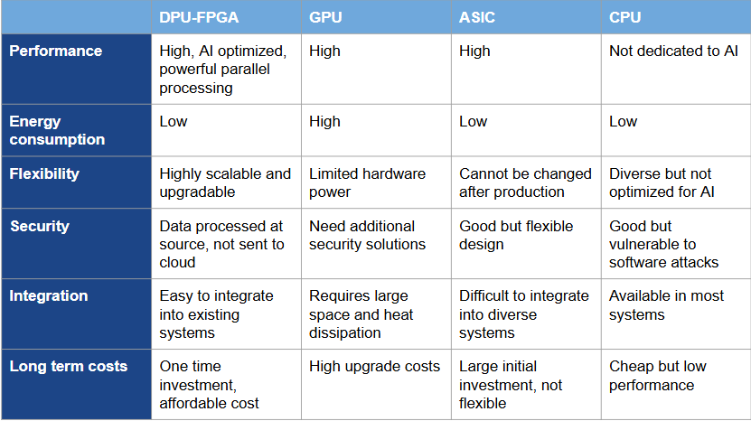
Benefit
Evaluating technologies in AI tasks
VERON R&D
AI Semiconductor
Page 10

Slide 12

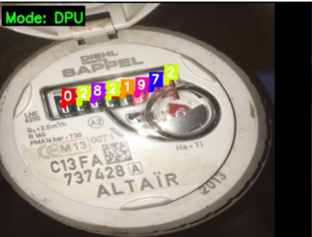
DPU Smart Water Box
Water’s quality smart management system
A Water’s Quality Smart Management System is an integrated solution that leverages advanced sensors, IoT connectivity, and artificial intelligence to continuously monitor, analyze, and manage the quality of water in real-time
The challenges
Optimizing Energy Consumption for Edge AI
Reliable & robust for outdoor use
Optimizing AI Models for the Edge (FPGA)
Technology Transfer
Scope
Technical Documents
Firmware, Sotfware
Hardware
Design process
Transitional stages
Stage 1: Transfer Planning
Stage 2: Survey, Deployment, Installation
Stage 3: Acceptance and Evaluation
Post-transfer support
Software updates, bug fixes, regular upgrades
Performance evaluation, system optimization
Expansion, integration, improvement consulting
Provide support team, online knowledge base, regular maintenance packages
Solutions
Multi-sensor hardware integration on FPGA
Optimizing AI models for the Edge
Manage and transmit data with IoT transmission standards
Manage, control, update remotely with OTA supported firmware
Optimize energy and durability
Application
Monitor water meter readings
Water quality management in industry
Pond and aquaculture monitoring
THIEN AN TECHNOLOGY INVESTMENT CORPORATION
Website: www.tacorp.vn
The Result
Monitor water usage and water quality
Save energy, reduce latency
Real-time operations
VERON R&D
AI Semiconductor
Page 11

Slide 13
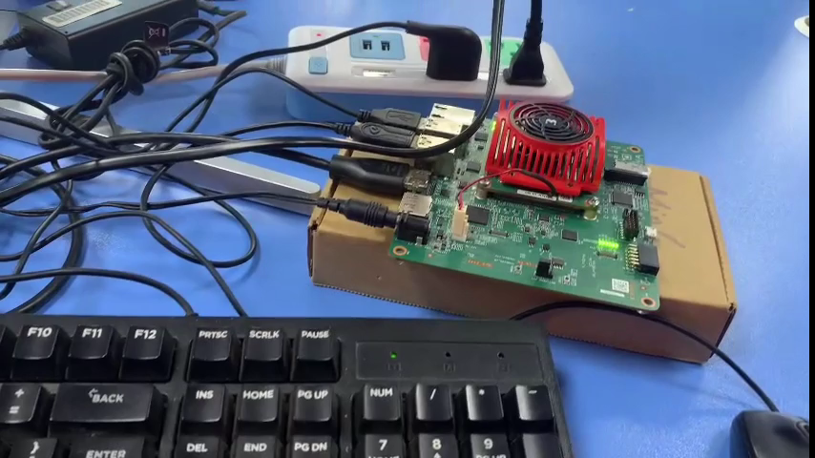

Slide 14
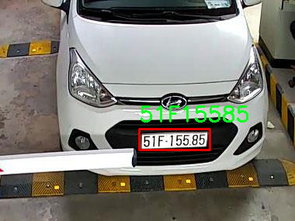
Smart Traffic Box
Traffic smart management system
The Traffic Smart Management System is a solution that integrates sensors and Edge AI hardware to monitor, analyze and control urban traffic in real time. The system helps identify Vietnamese vehicle’s license plate in many place like parking lot in hospital, mall or in the crossroads section
The challenges
High-speed multi-stream processing of image/video data
Integrated multi-communication, signal synchronization
Technology Transfer
Scope
Technical Documents
Firmware, Sotfware
Hardware
Design process
Transitional stages
Stage 1: Transfer Planning
Stage 2: Survey, Deployment, Installation
Stage 3: Acceptance and Evaluation
Post-transfer support
Software updates, bug fixes, regular upgrades
Performance evaluation, system optimization
Expansion, integration, improvement consulting
Provide support team, online knowledge base, regular maintenance packages
Solutions
Design of multi-threaded, distributed systems
Optimizing Hardware and AI Models for the Edge
Application
Automatic vehicle and license plate recognition in parking lot
Identify car license plate and calculate the violation cause at the crossroads.
The Result
Save operating costs, easy expansion
Optimize resources
Increase the efficiency of traffic monitoring and management
VERON R&D
AI Semiconductor
Page 12

Slide 15
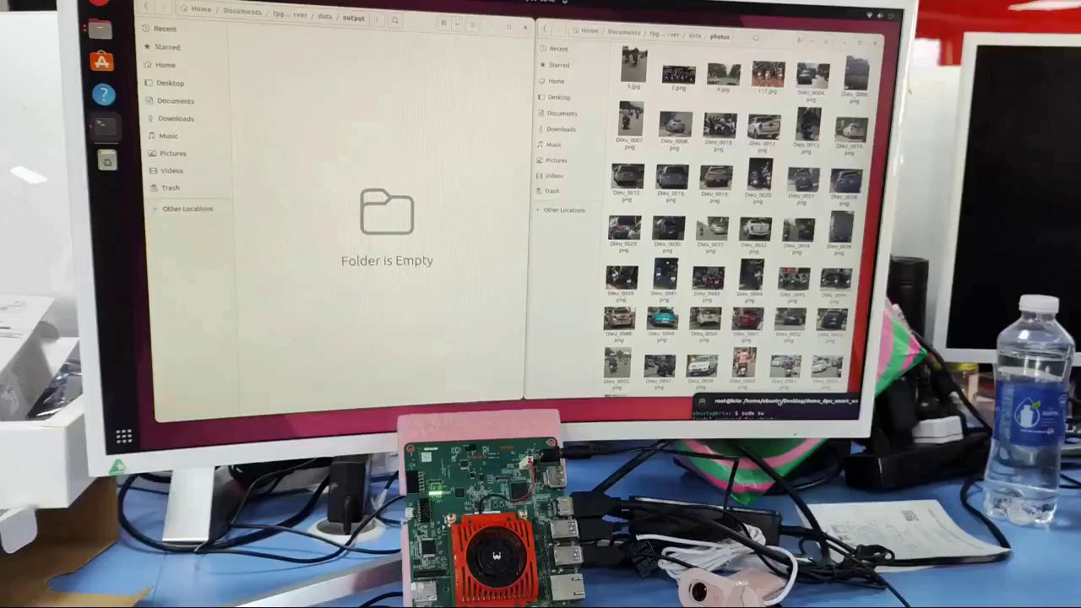

Slide 16
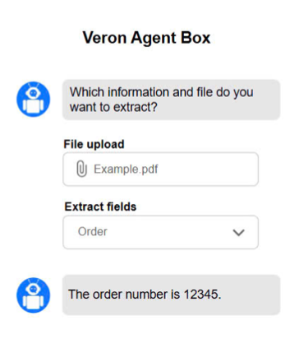
AI Chat Box
Smart Profile Management System in the form of AI Chat Box
The intelligent profile management system in the form of AI chatbot allows users to easily look up, update and manage profiles through an automated chat interface, helping to simplify operations, personalize the experience and increase information management efficiency.
The challenges
Understand user intent correctly
Security and Privacy
Ensure accuracy and updates
Technology Transfer
Scope
Technical Documents
Firmware, Sotfware
Hardware
Design process
Transitional stages
Stage 1: Transfer Planning
Stage 2: Survey, Deployment, Installation
Stage 3: Acceptance and Evaluation
Post-transfer support
Software updates, bug fixes, regular upgrades
Performance evaluation, system optimization
Expansion, integration, improvement consulting
Provide support team, online knowledge base, regular maintenance packages
Solutions
Flexible integration API
Automatic verification and validation mechanism
Multi-factor authentication and data encryption
Cloud computing infrastructure
Application
Personnel records management in the enterprise
Support online public services
Automated customer care
The Result
Simplify records management and retrieval processes
Save time and operating costs
VERON R&D
AI Semiconductor
Page 13

Slide 17
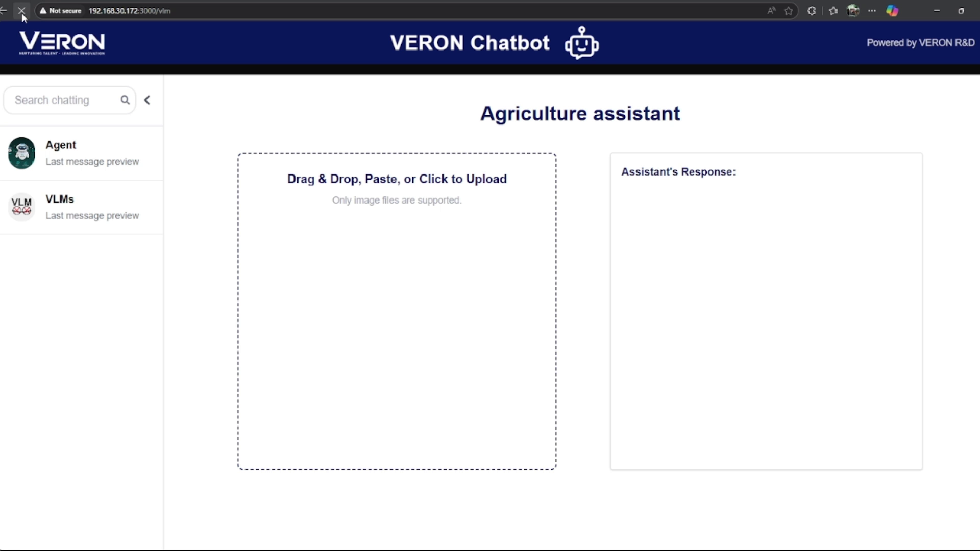

Slide 18
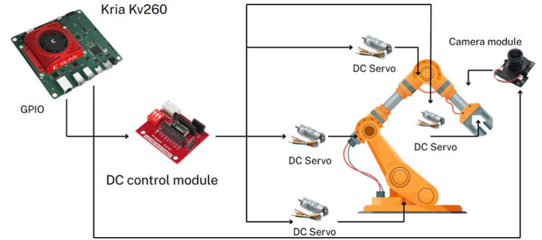
Robotic arm system with Edge AI
AI Box for robotic arm system with Edge AI (FPGA) is a dedicated hardware device, integrating AI models on the FPGA platform, used to process, control, and optimize the operation of robotic arms right on the field (Edge). The system allows image recognition, sensor signal processing, and quick movement decisions without depending on the cloud or central server.
The challenges
Multi-sensor and communication integration
Ensure real-time response
Security and operational safety
Technology Transfer
Scope
Technical Documents
Firmware, Sotfware
Hardware
Design process
Transitional stages
Stage 1: Transfer Planning
Stage 2: Survey, Deployment, Installation
Stage 3: Acceptance and Evaluation
Post-transfer support
Software updates, bug fixes, regular upgrades
Performance evaluation, system optimization
Expansion, integration, improvement consulting
Provide support team, online knowledge base, regular maintenance packages
Solutions
Deploying specialized AI models on FPGA
Building a sensor data processing pipeline
Integrated industrial communication standards
Multi-layered security
Application
Automatic production line
Product classification and packaging
Medical or laboratory support
Logistics and smart warehouse
The Result
Increase processing speed and response
Increase automation and flexibility
Easy to integrate and expand
VERON R&D
AI Semiconductor
Page 14

Slide 19

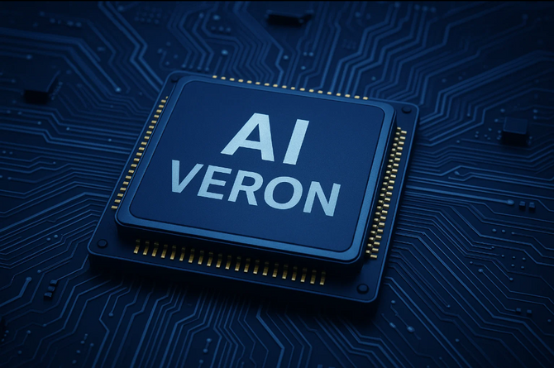
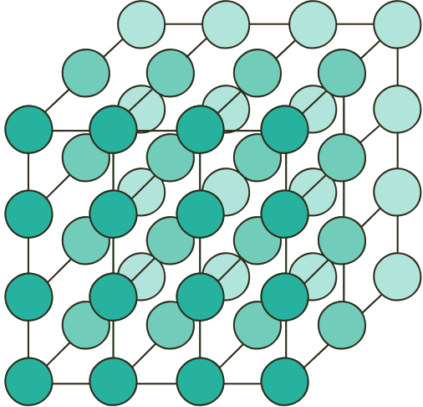



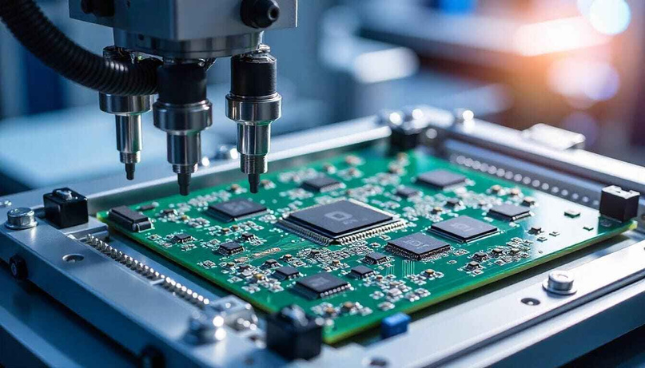
Capability
Custom IP Design
Custom AI models
Design, development and packaging of Semiconductor IPs
Develop suitable AI models based on requirements
Customer Solutions
Custom Boards
Developing circuit boards based on PCB (Printed Circuit Board) technology solutions
VERON R&D
AI Semiconductor
Page 15

Slide 20
